Slide 1
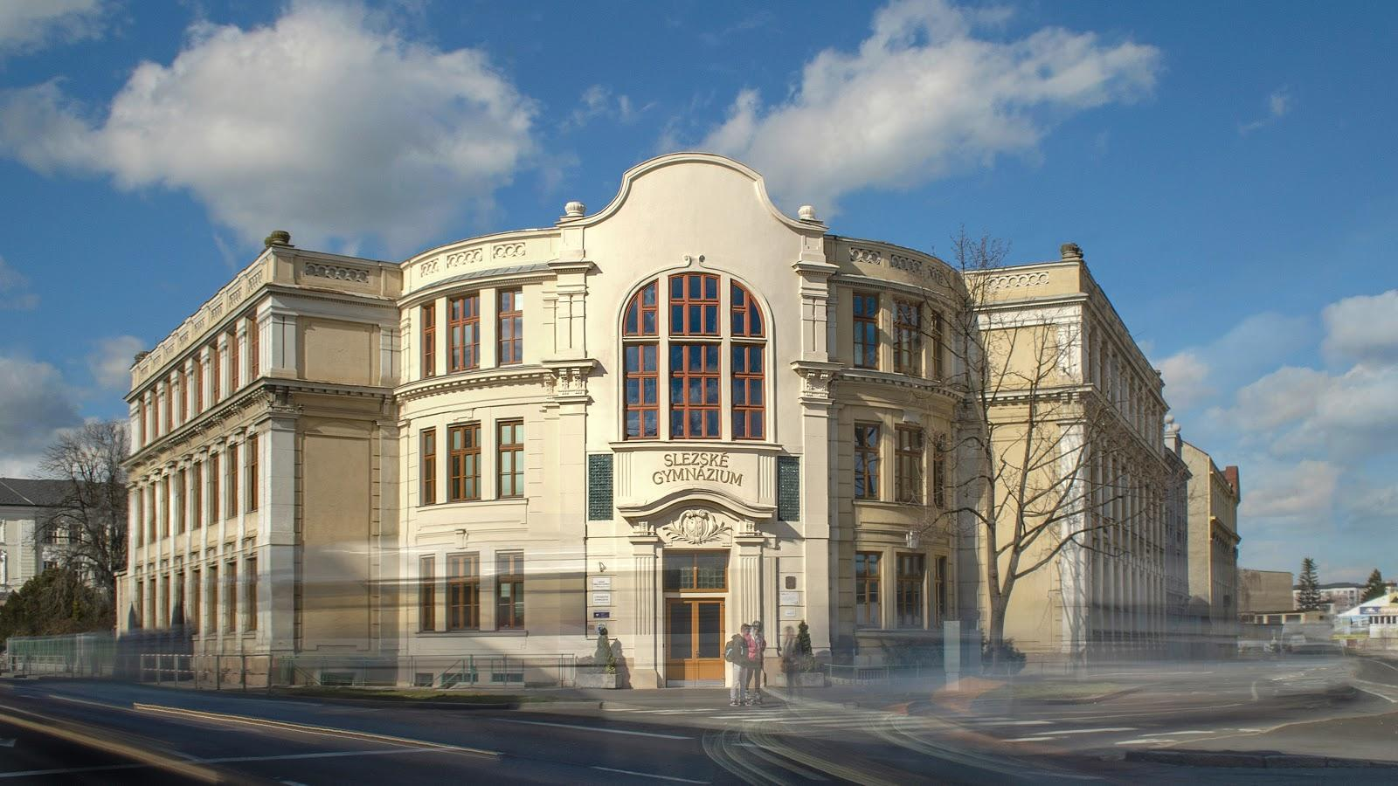
Project EMISSIONS
Silesian Grammar School
Opava

Slide 2
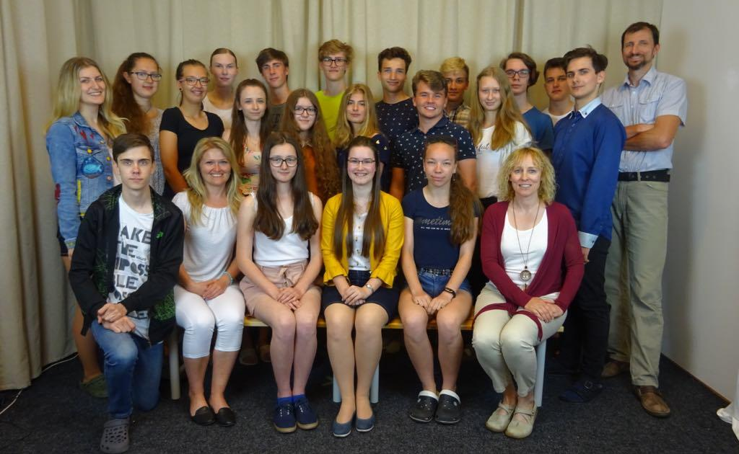
WHO ARE WE?

Slide 3
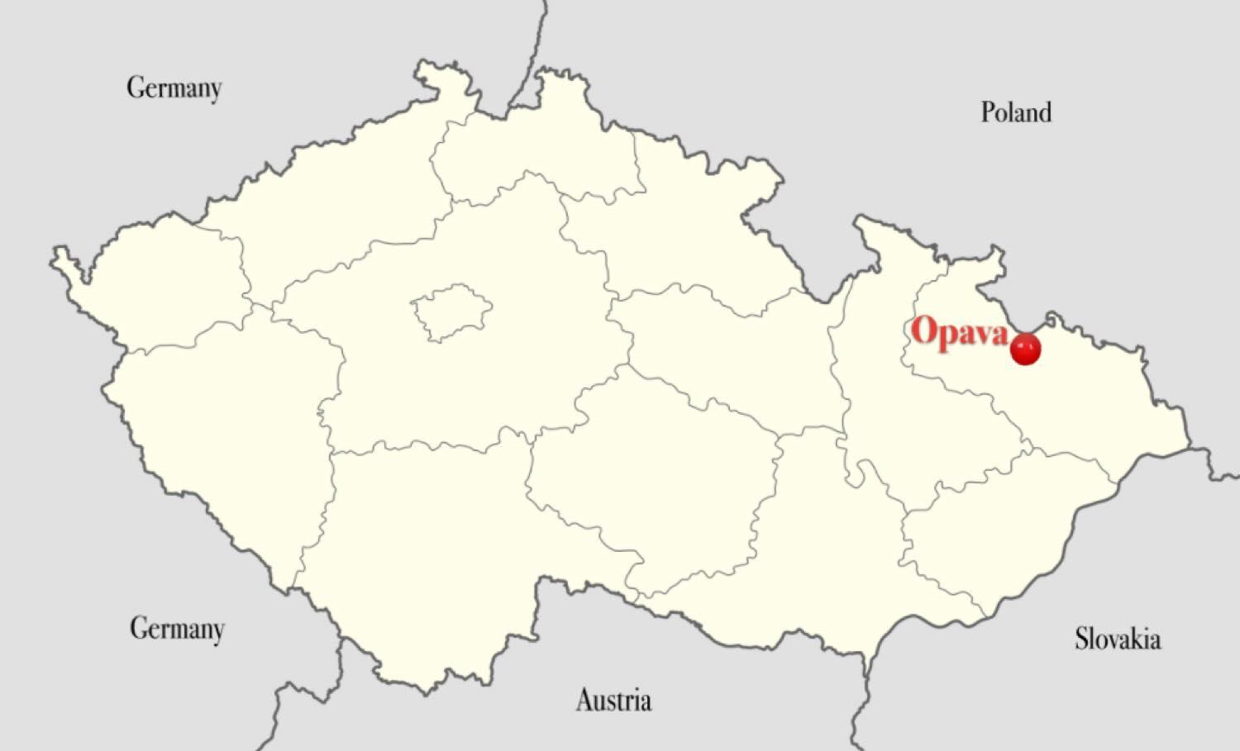
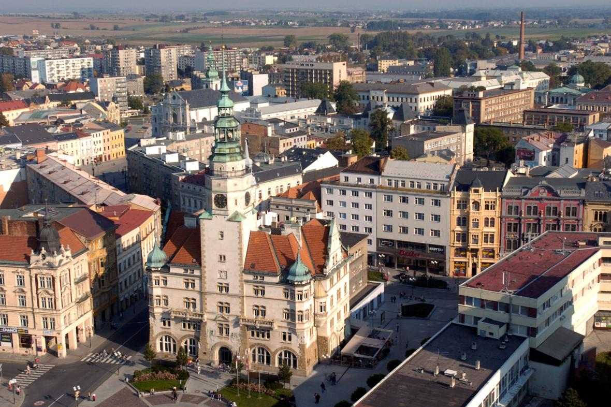
WHERE ARE WE FROM?

Slide 4
HISTORY
2012
2017
2021
air pollution
light pollution

Slide 5
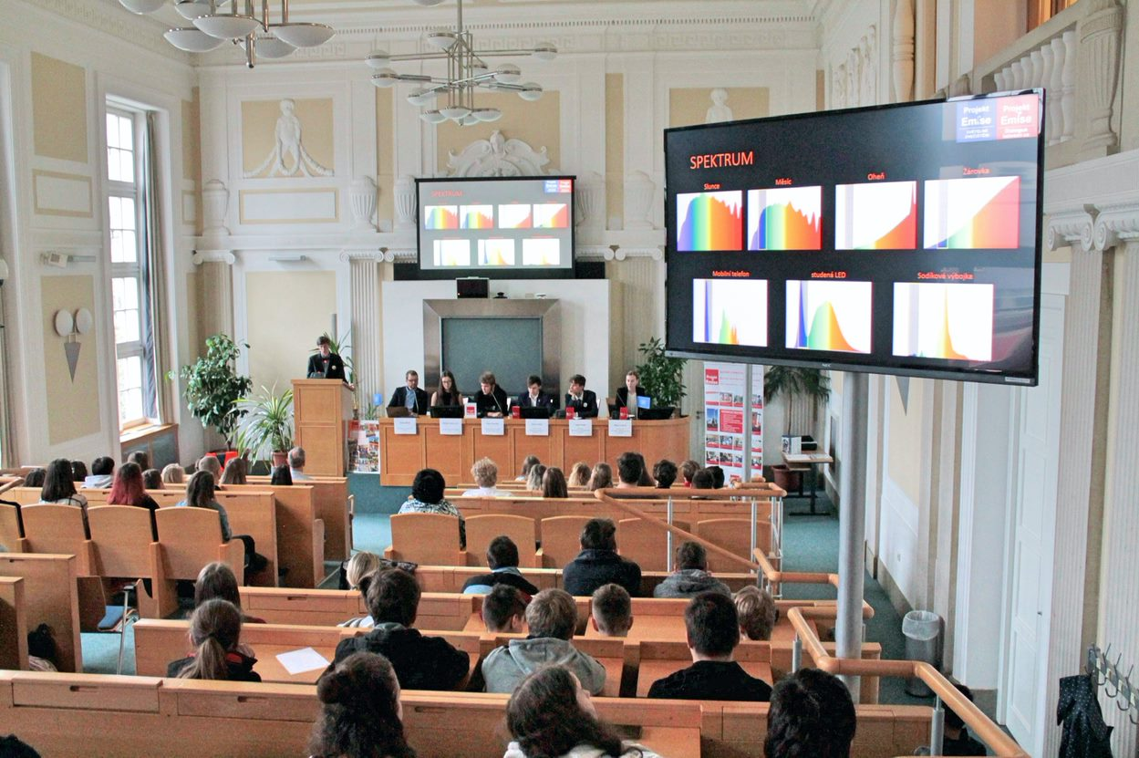
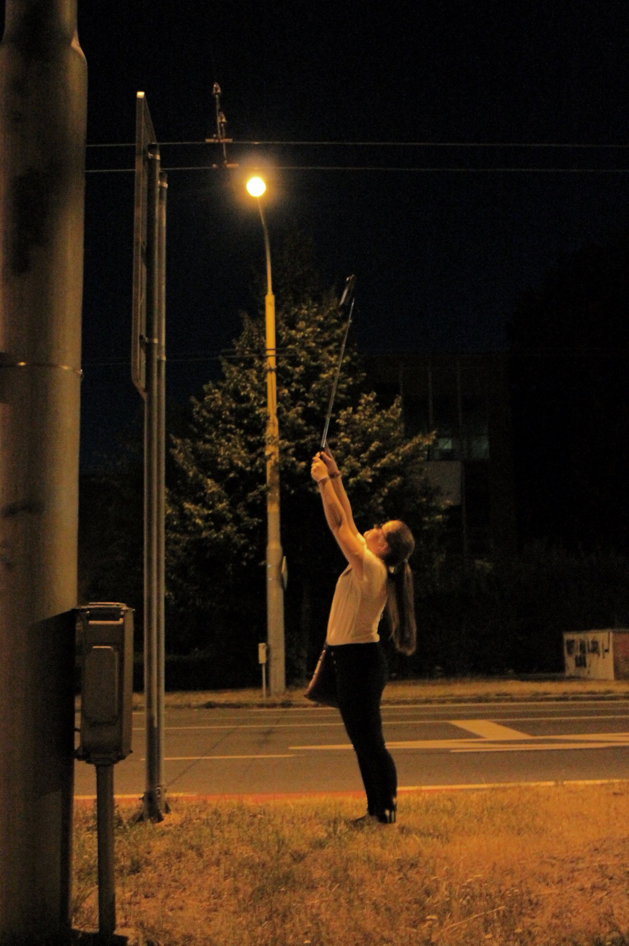
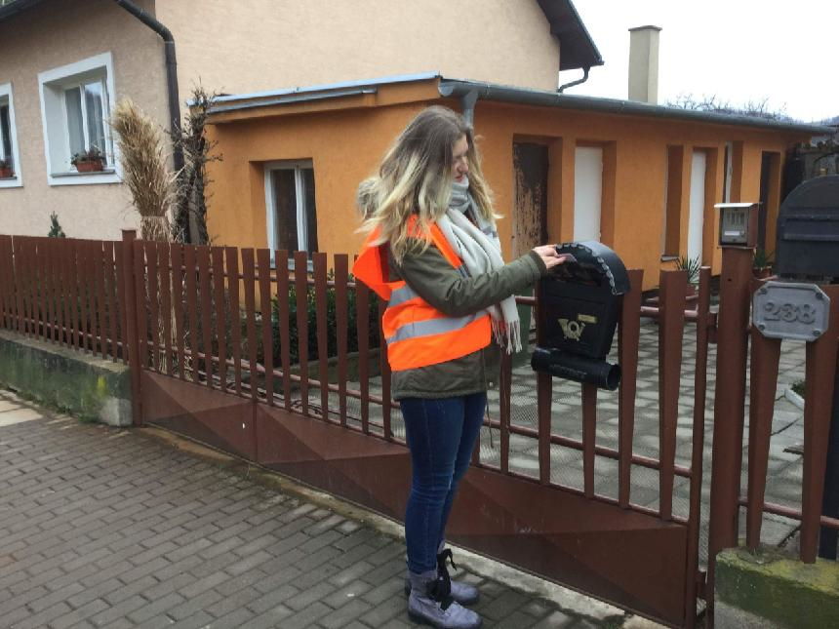
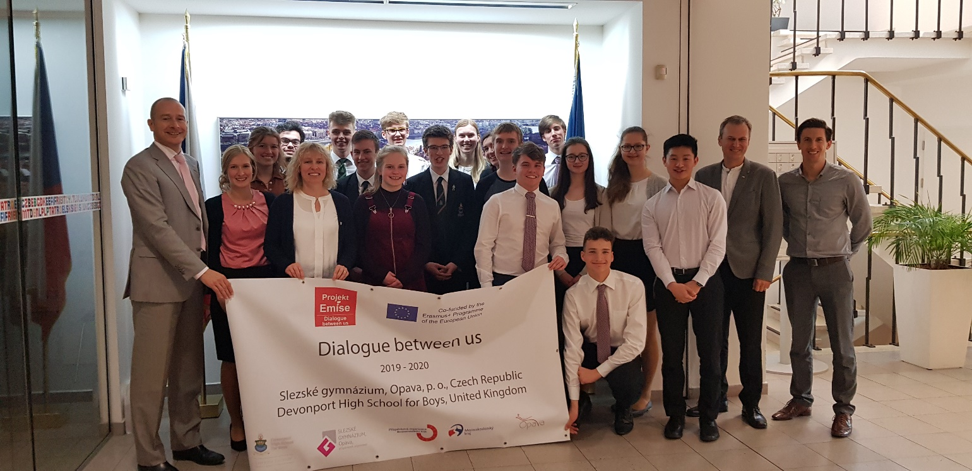
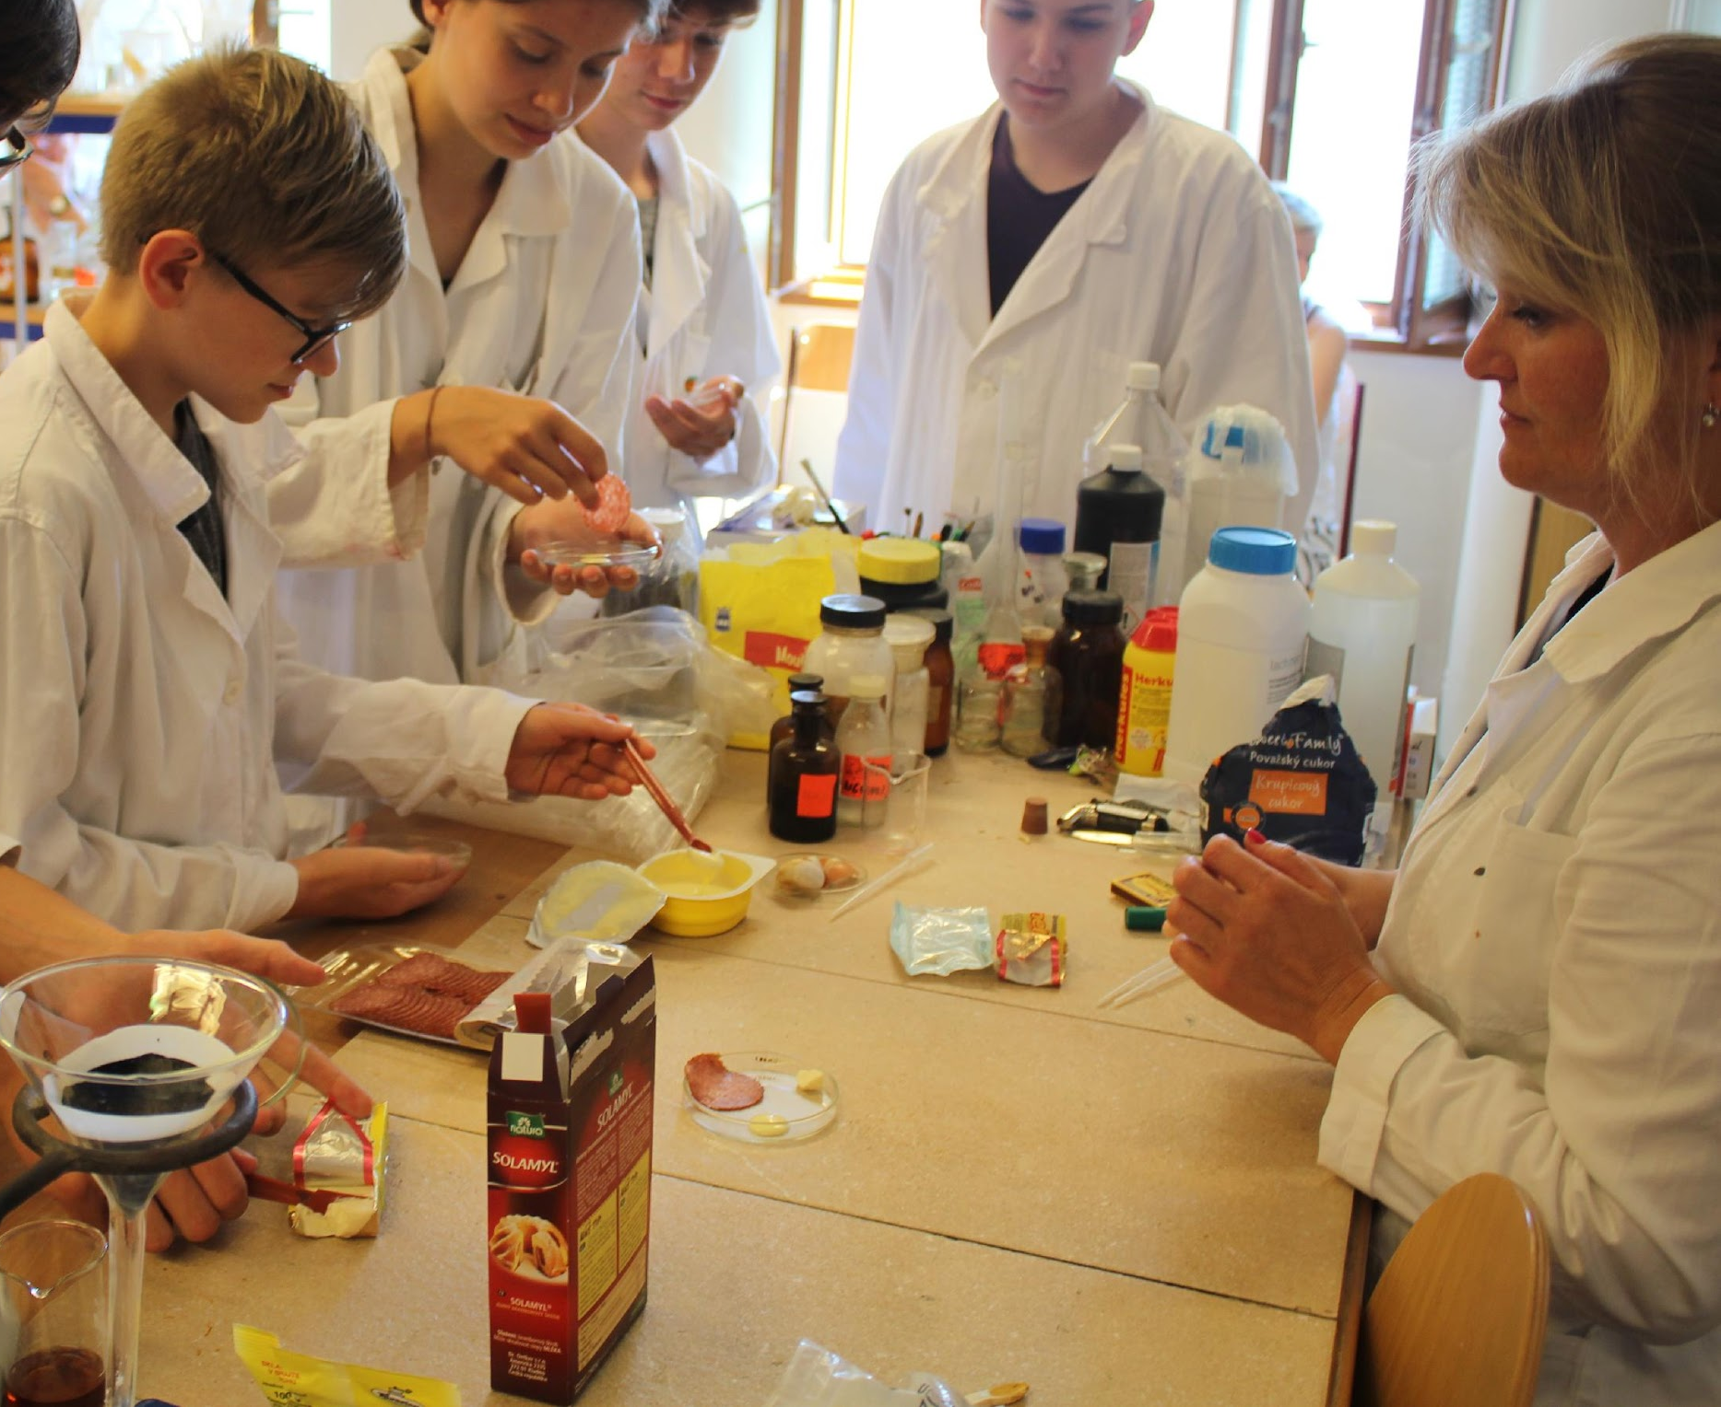
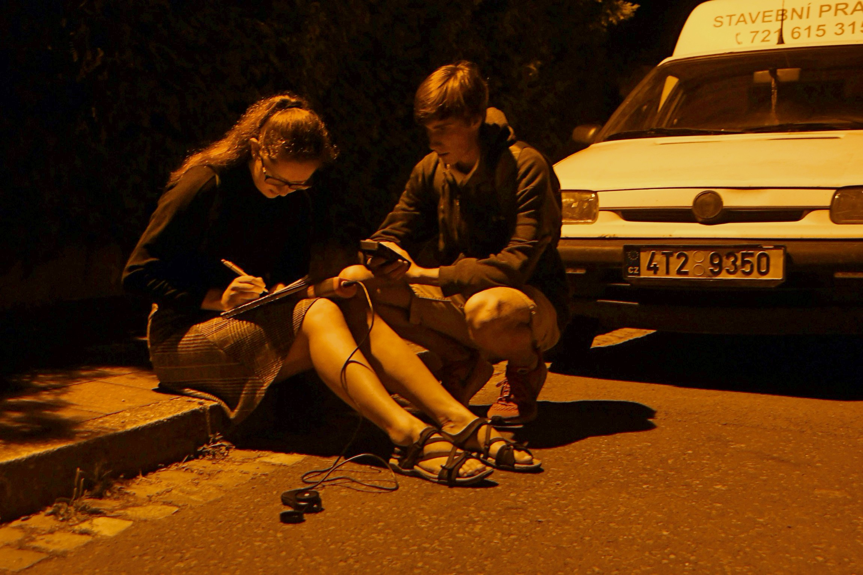
WHAT DO WE DO?

Slide 6
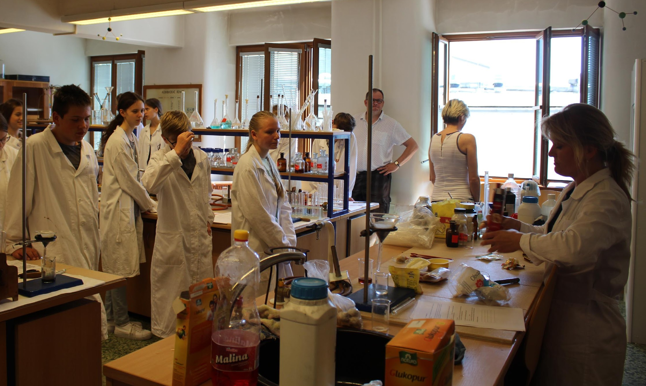
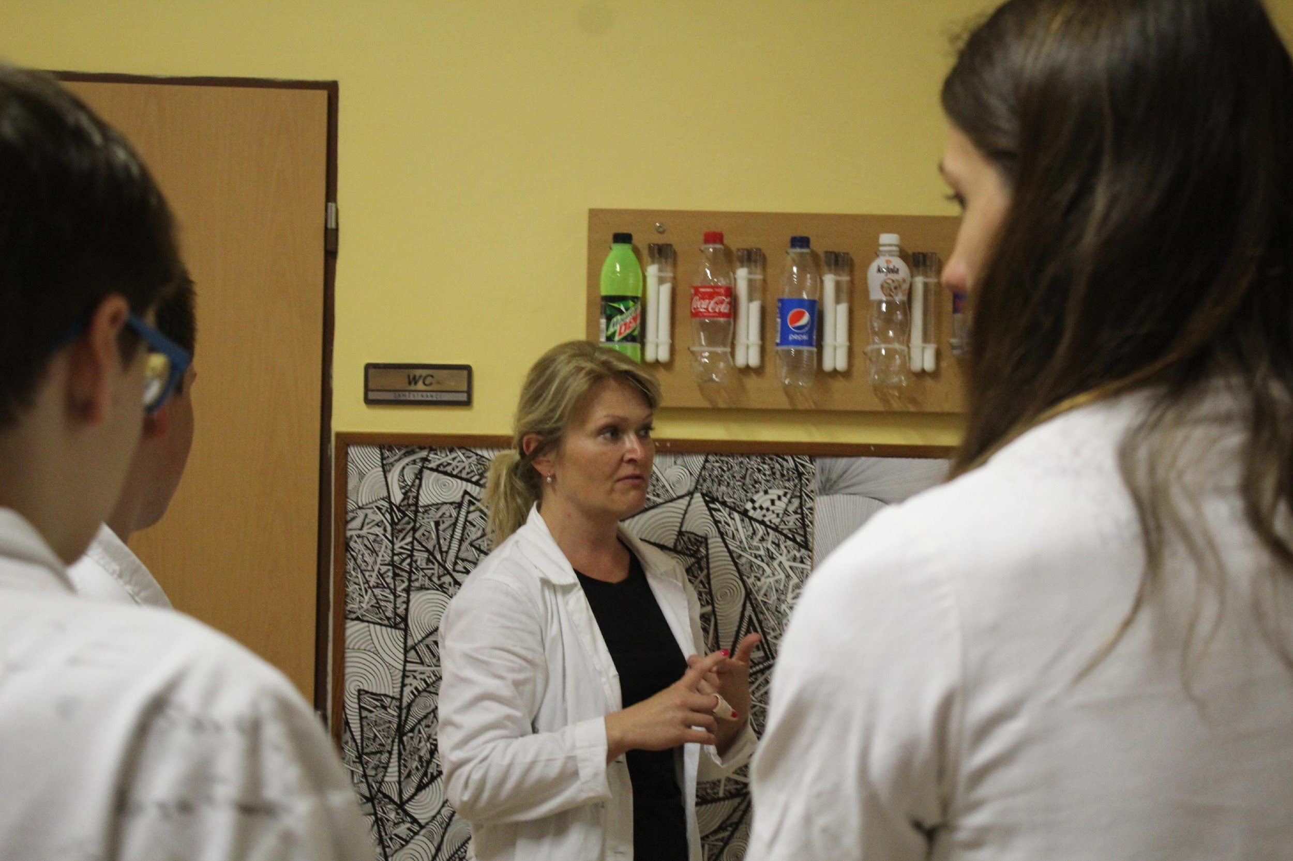
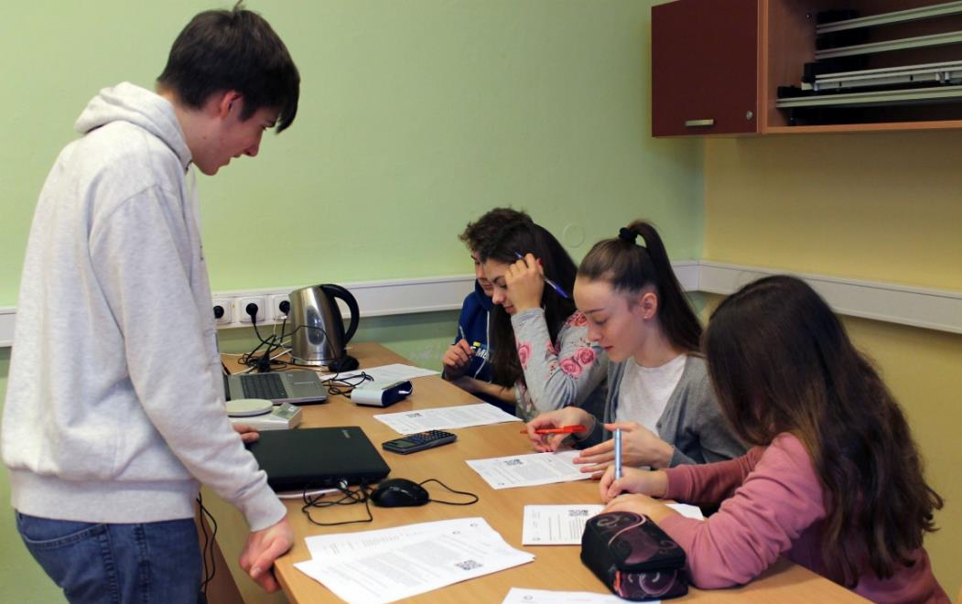
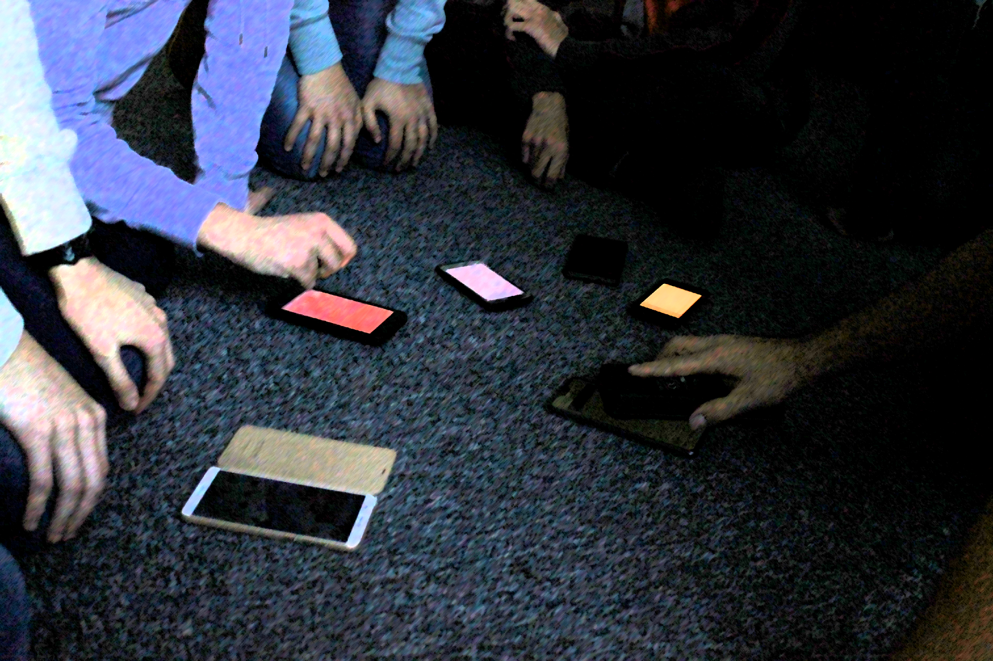
educate secondary schools

Slide 7
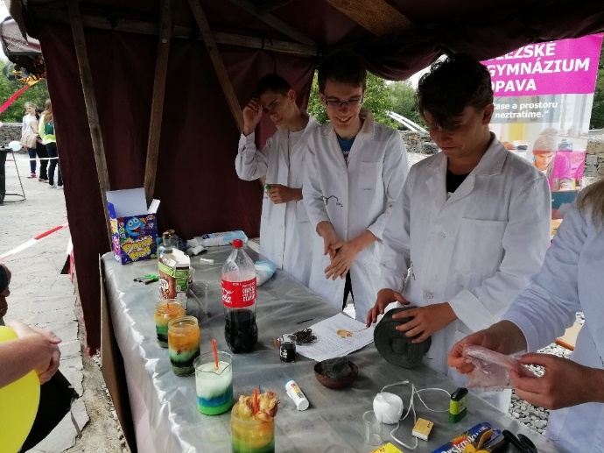
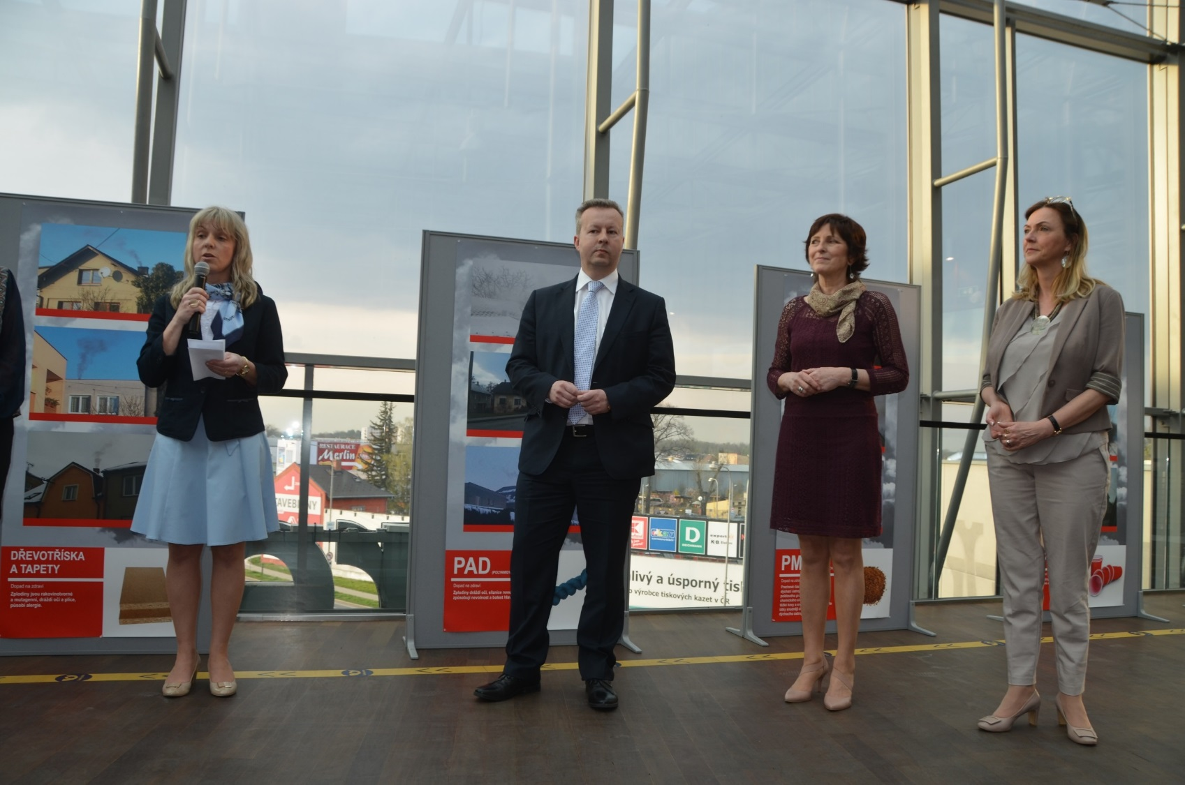
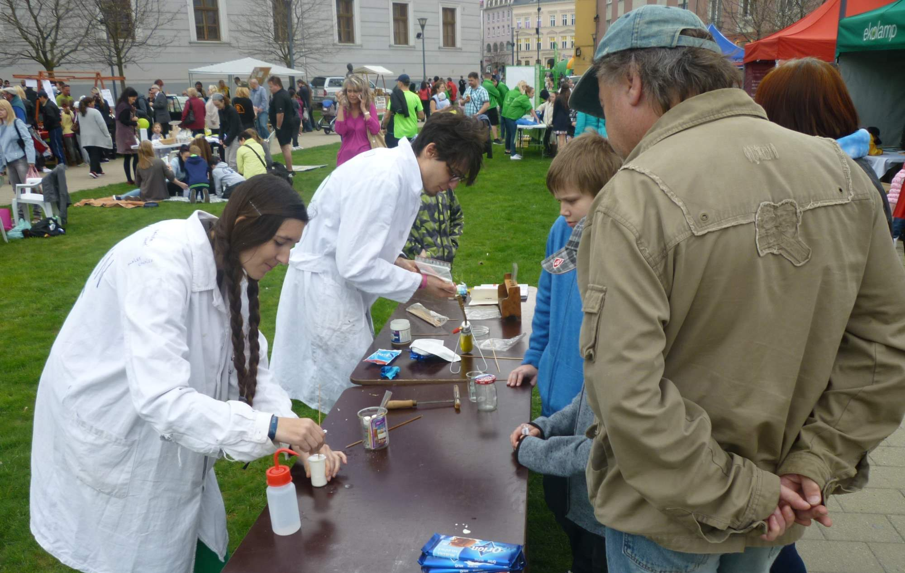
present to the public

Slide 8
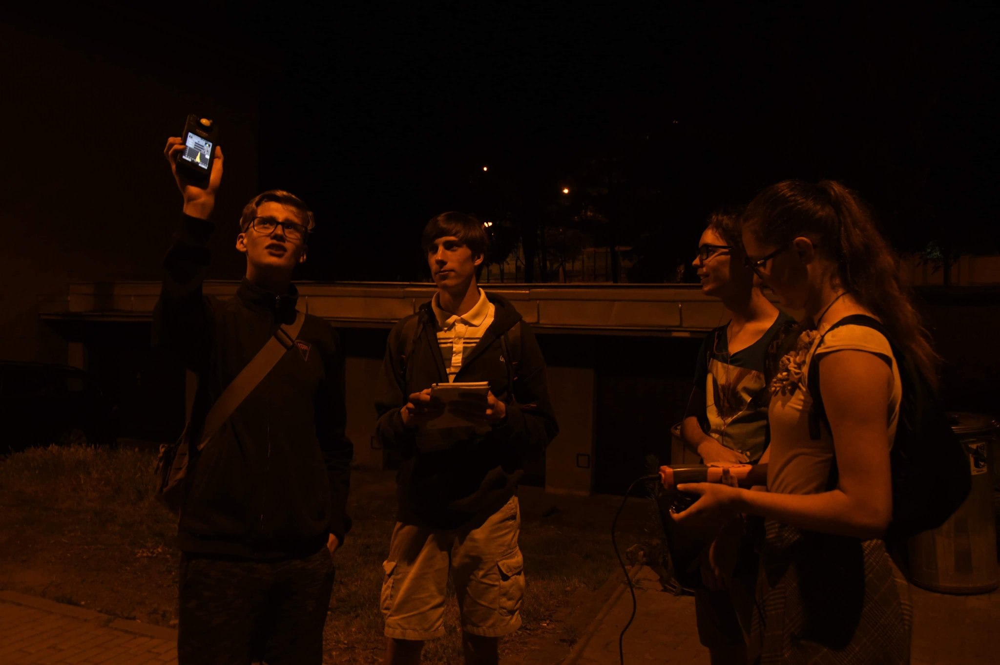
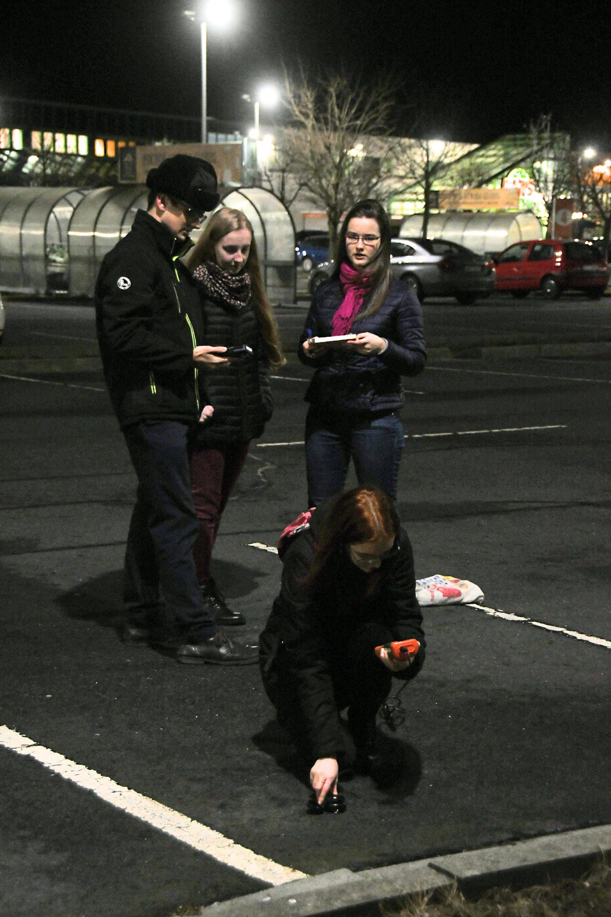
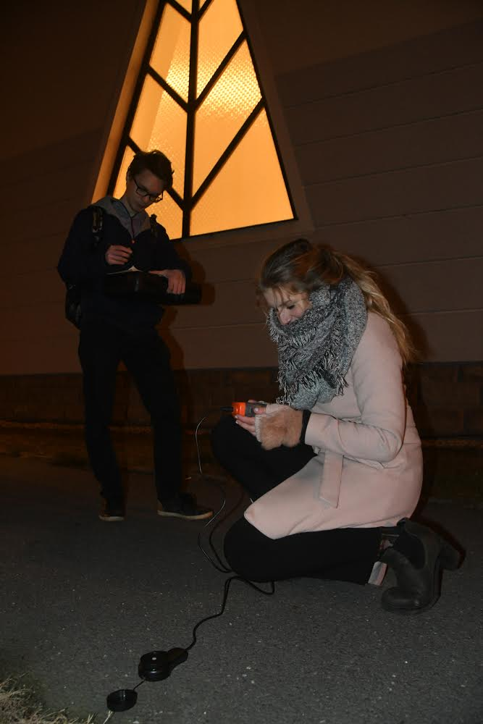
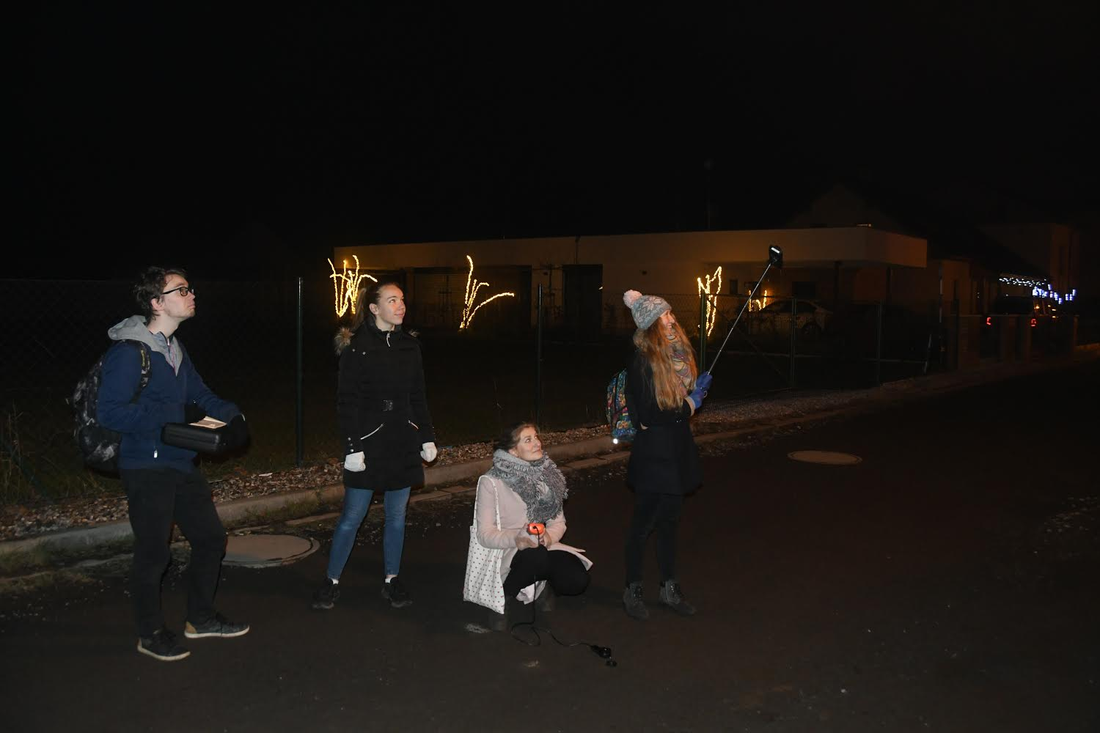
measure light pollution in Opava

Slide 9
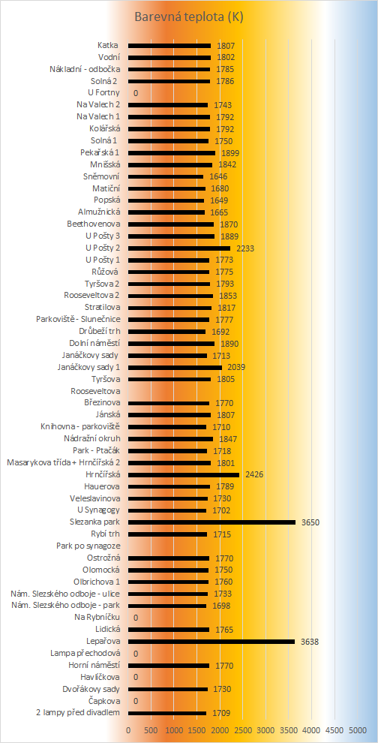
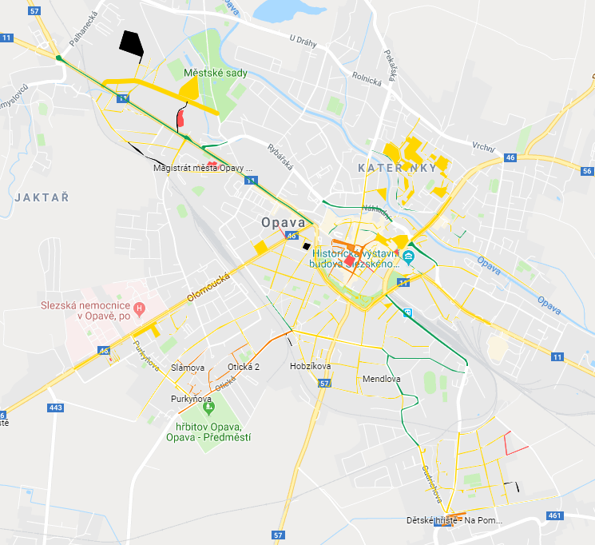
create tables, graphs and maps

Slide 10
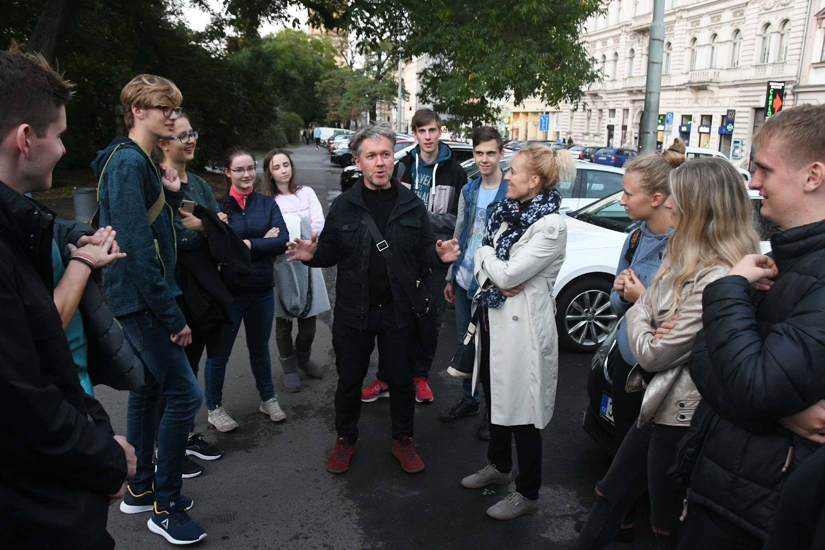
consult with experts

Slide 11
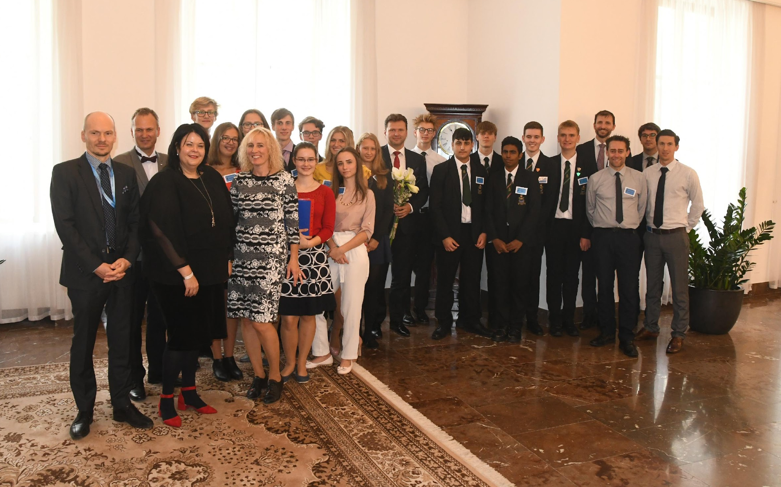
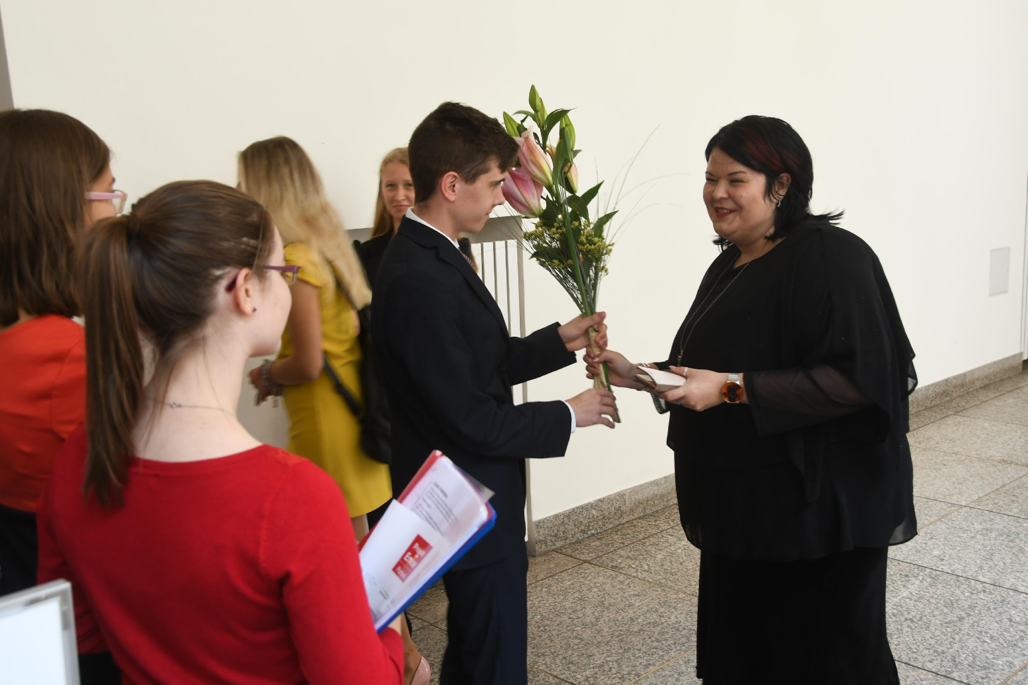
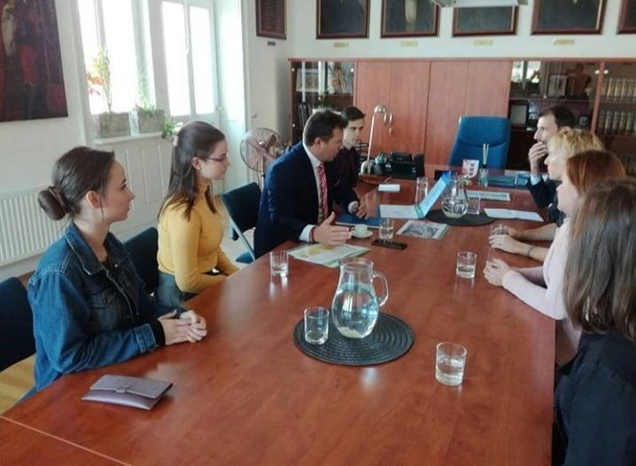
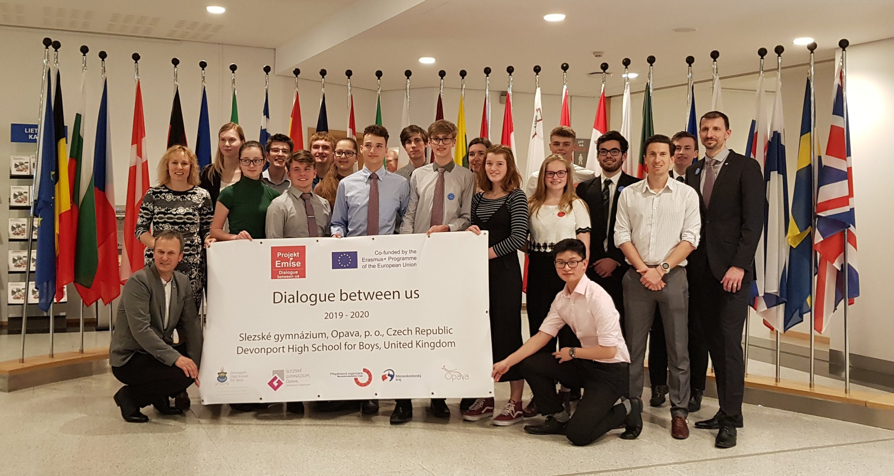
meet with politicians

Slide 12
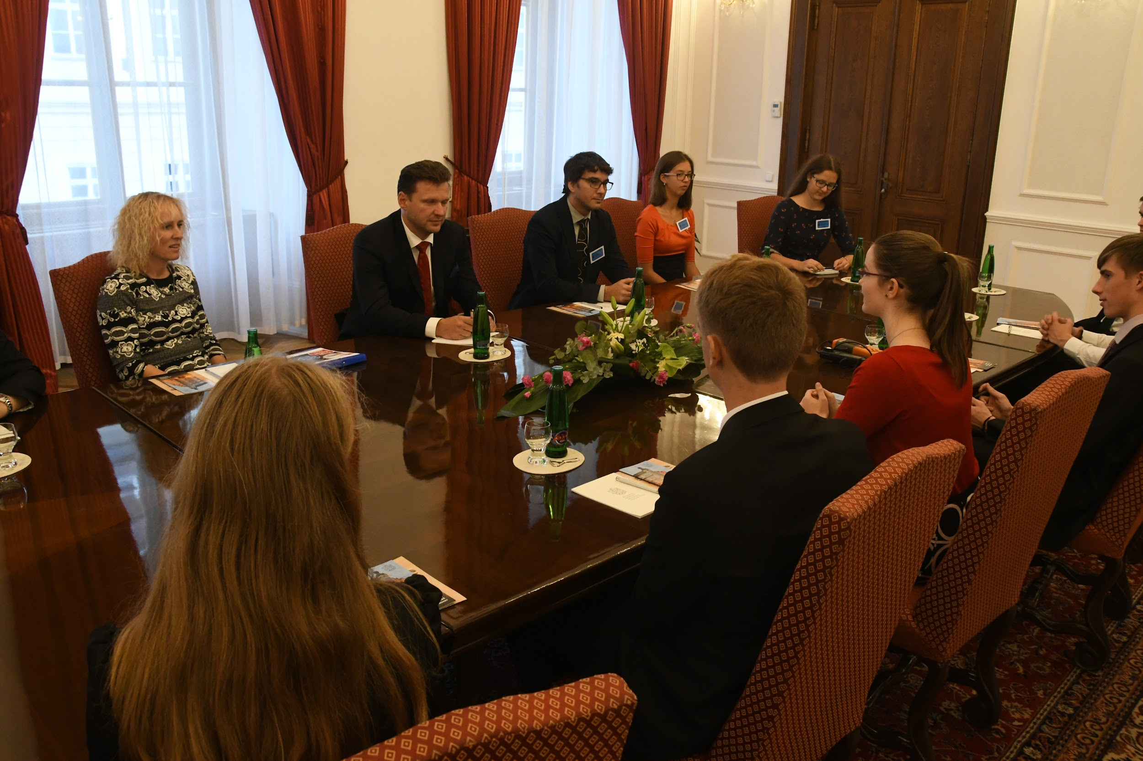
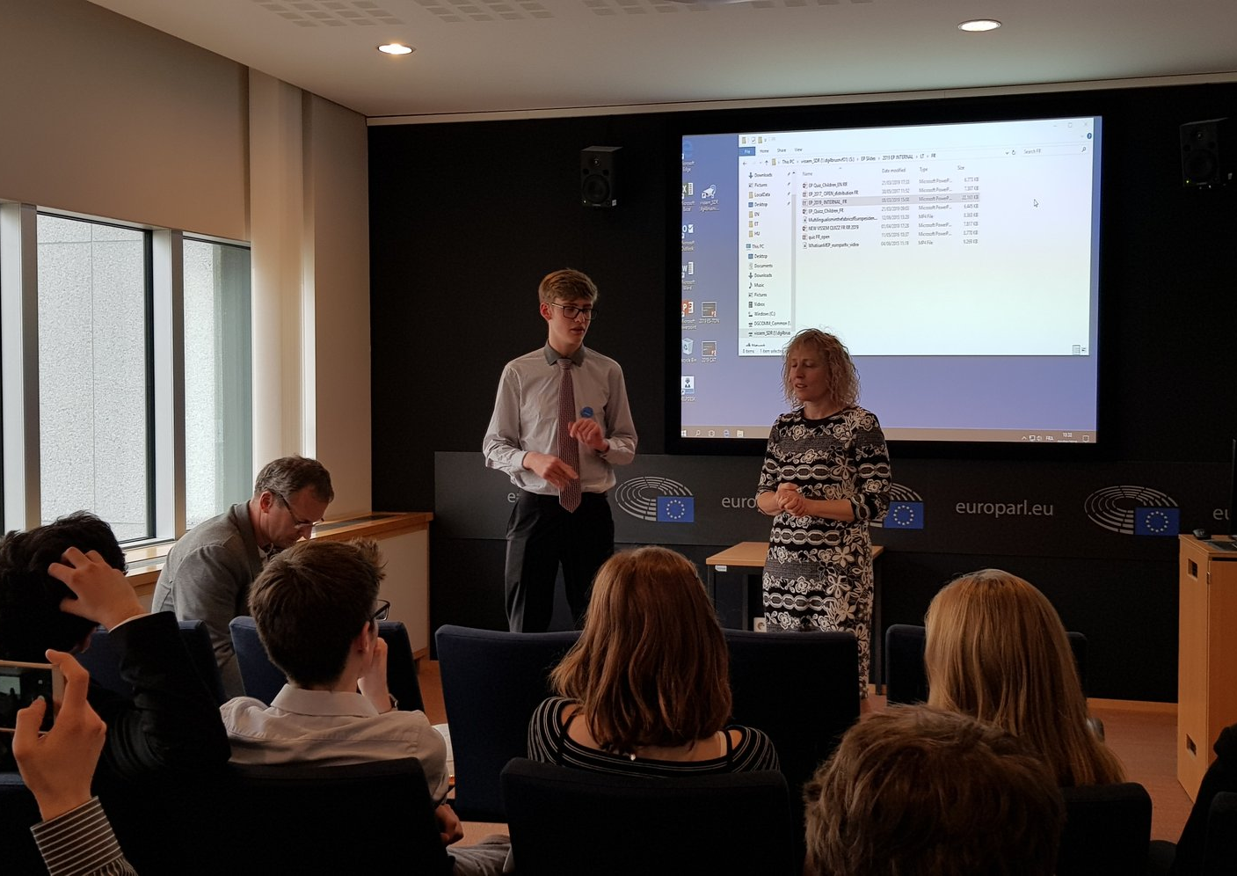
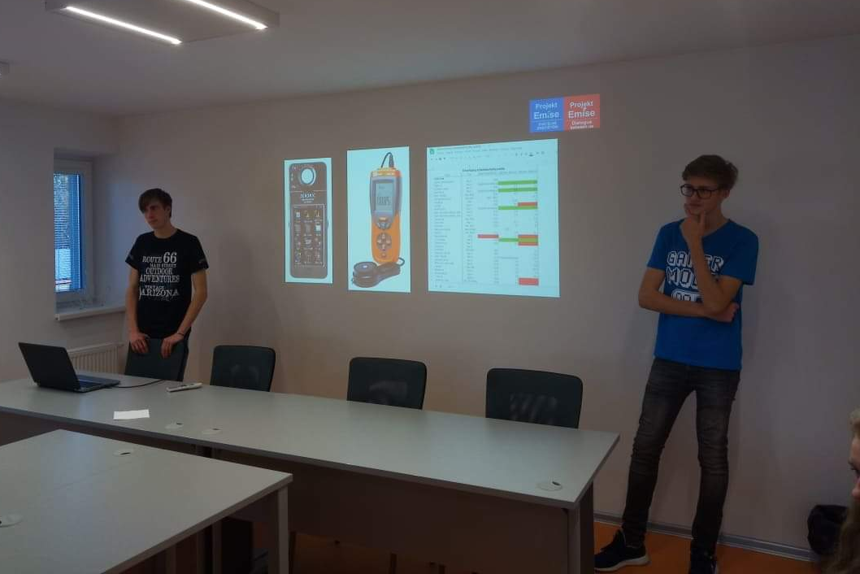
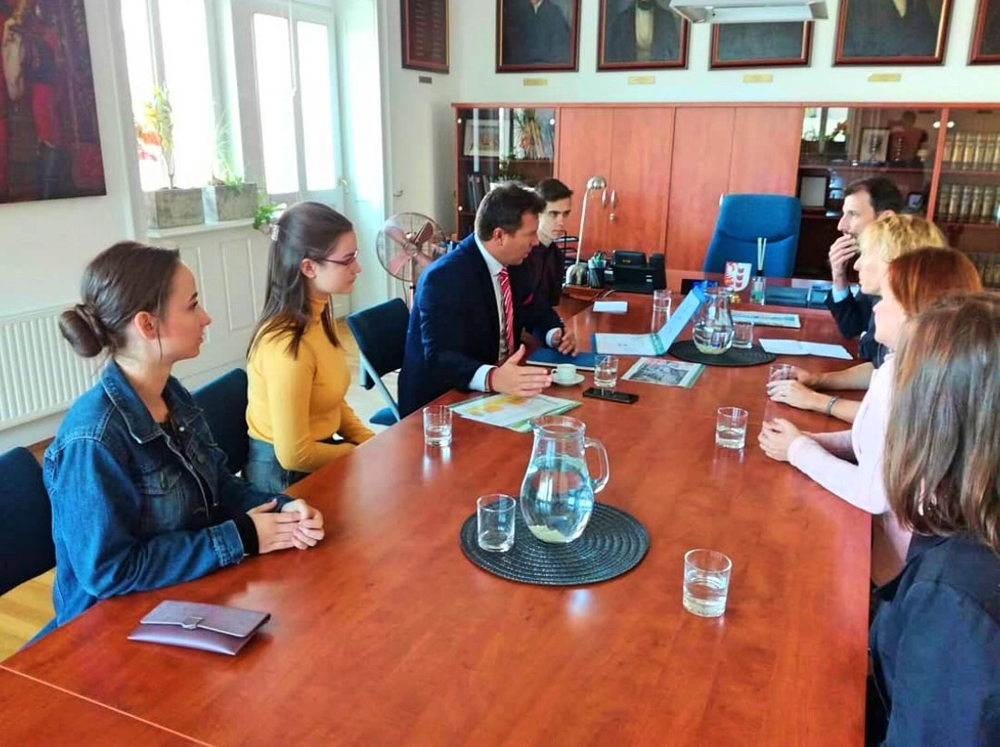
city officials
regional council
national parliament
European union

Slide 13
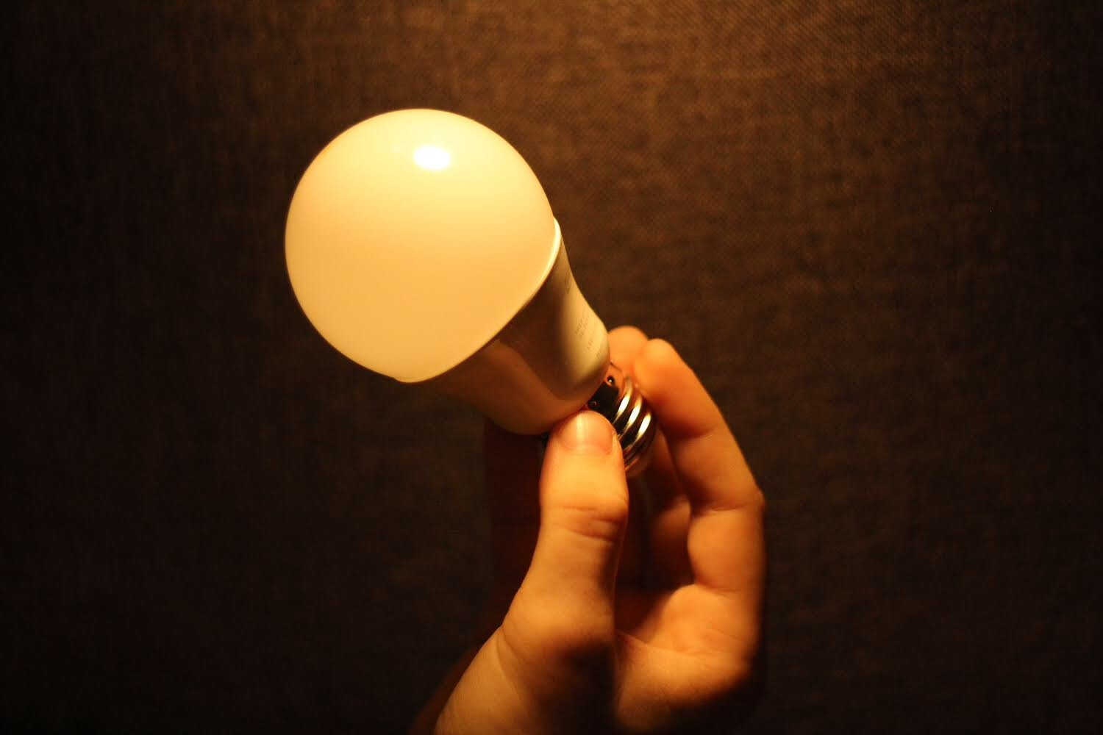
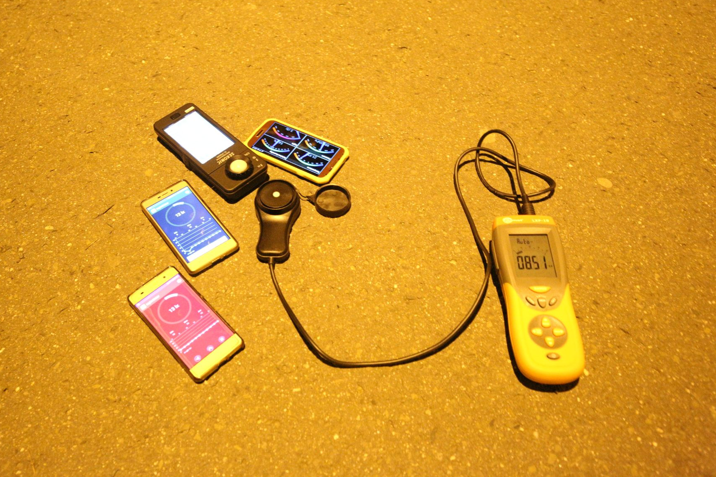
INITIATIVES FOR THE EUROPEAN COMISSION
Suggest a marking system for the cover of the bulbs in the store - whether they are appropriate or inappropriate for specific areas such as bedrooms, offices and so on
In the EU, require a reading mode including a blue light filter as a necessity for the mobile phones’ and tablets’ type-approval
Start up a Europe-wide public campaign spreading the word about light pollution

Slide 14
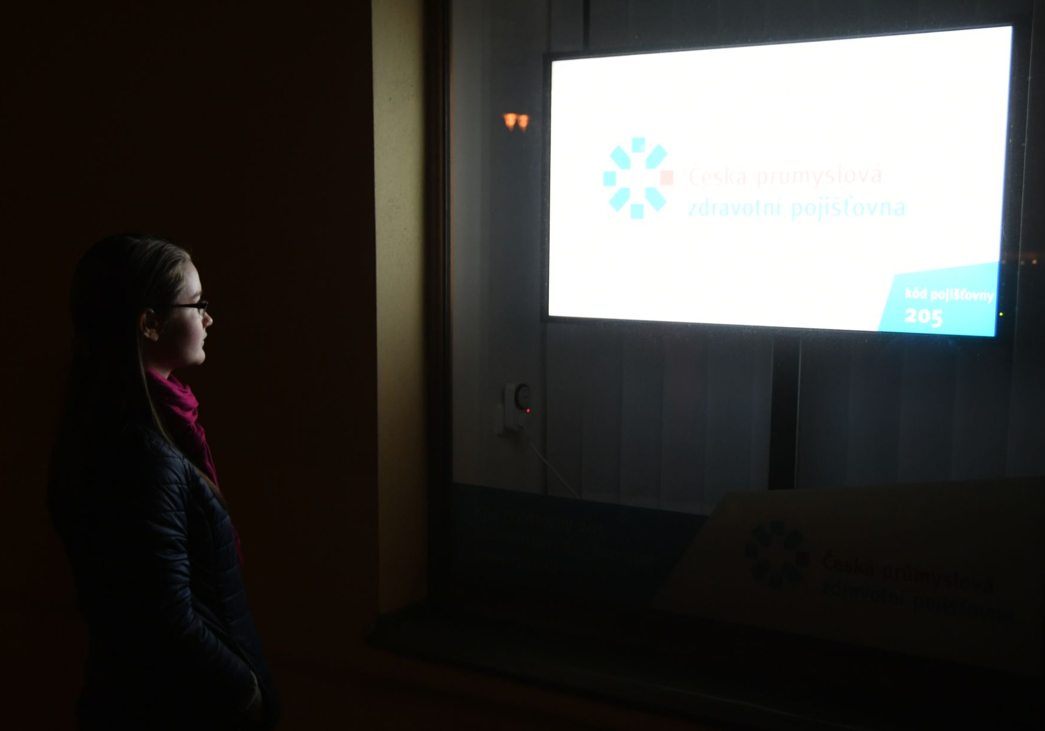
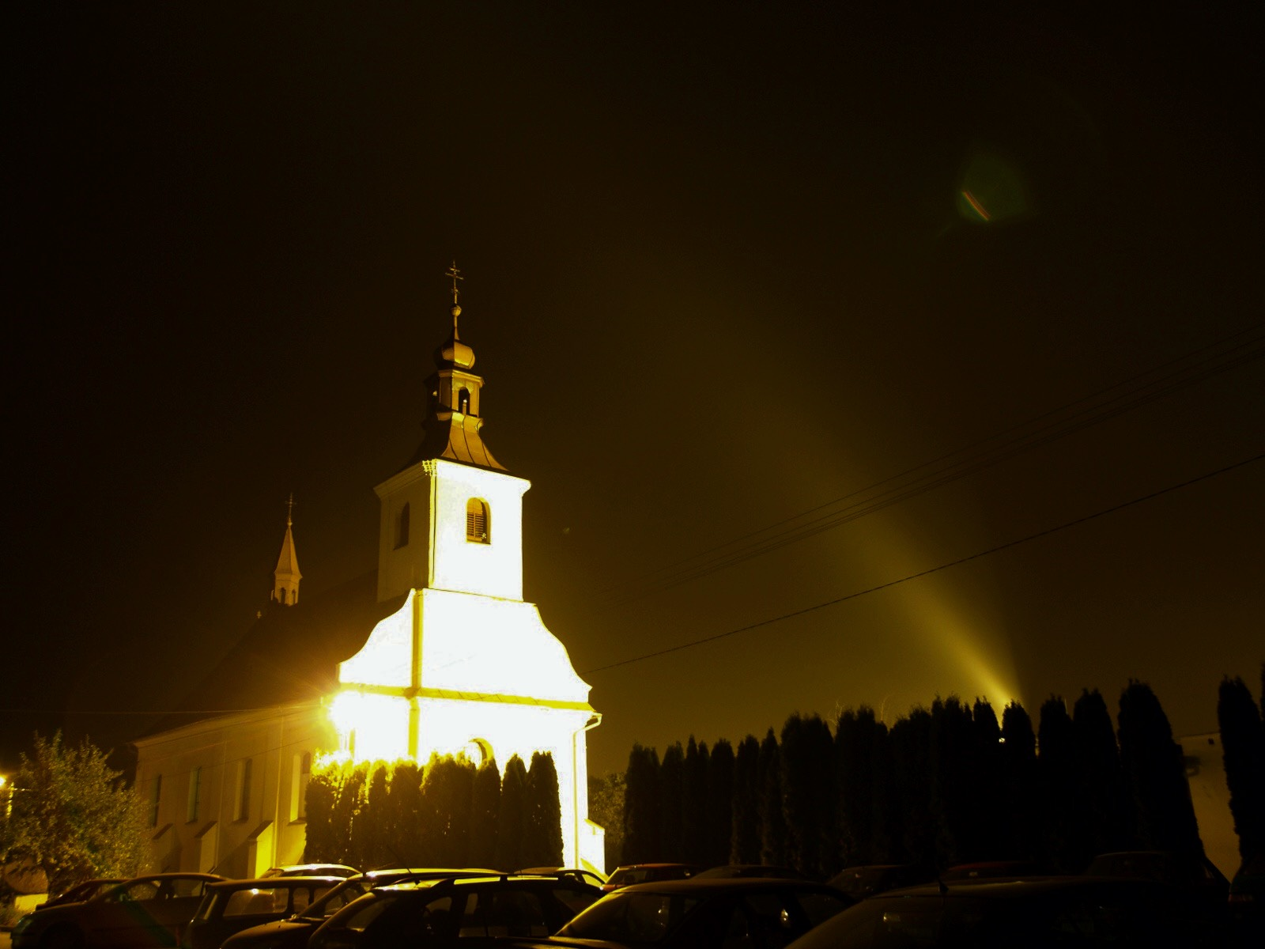
INITIATIVES FOR THE EUROPEAN COMISSION
Reduce the number of LED billboards emitting light. Make sure that they are turned off for the quiet hours, due to their endangering of the nocturnal animals
Set the upper limits of illumination in the streets, including the color temperature of the light source. Ban the use of bulbs with a color temperature over 2700K
Ban the illumination of public sights during quiet hours and adjust the shape of the light source according to the illuminated object, so that the light only shines upon said object

Slide 15
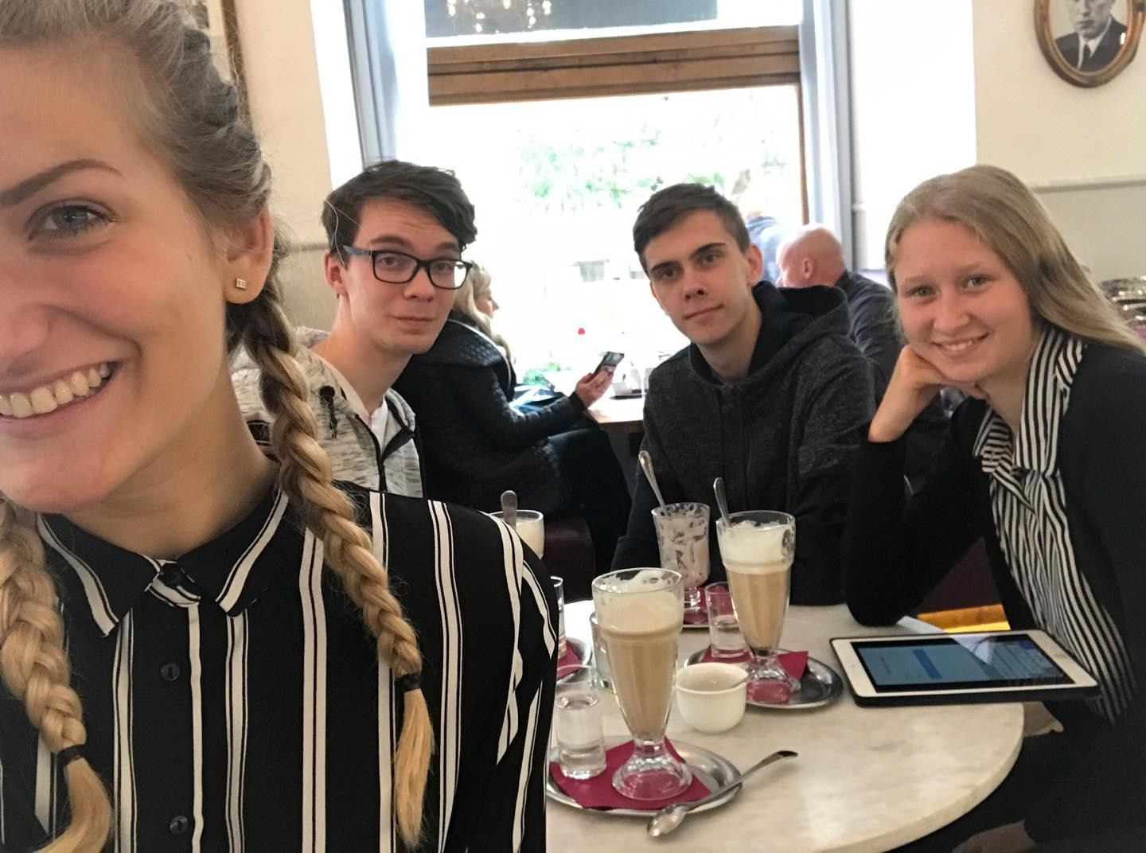
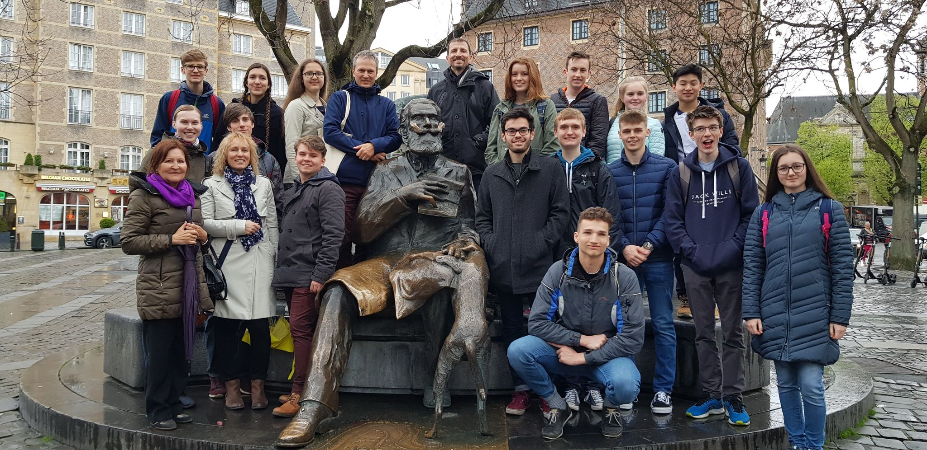
SOCIAL MEDIA
INSTAGRAM @projektemise
TWITTER Project Emise
WEBSITE www.emise.sgopava.cz
SCHOOL WEBSITE www.sgopava.cz

Slide 16
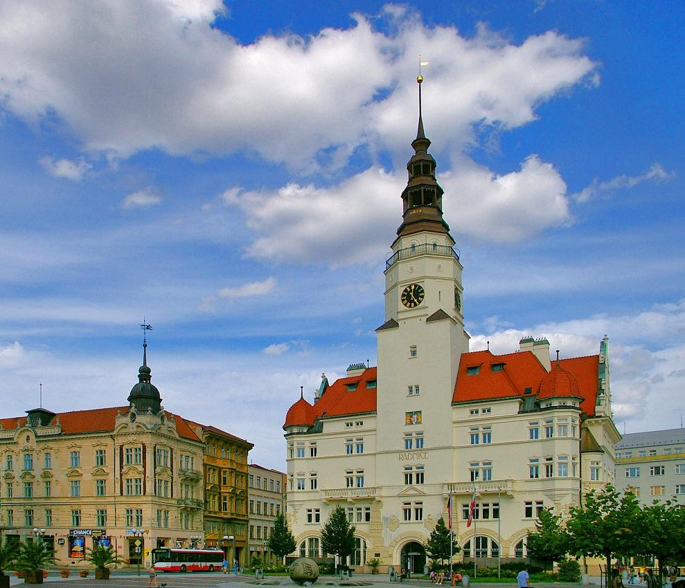
Opava City
New city district Stromovka

Slide 18
PUBLIC LIGHTING
zero ULOR
adjustable light intensity
motion sensors where legislation permits

Slide 19
THANK YOU FOR YOUR ATTENTION

